Slide 1
Strategies and Tools for Fake Messages in digital world
Team Details
B.Dinesh kumar ( 20EG105604)
B.Sreeja ( 20EG105607)
B.Shushanth ( 20EG105642)
Project Supervisor
Name : Dr. N. Swapna Goud

Slide 2
Introduction
In recent years, due to the booming development of online social networks, fake messages for various commercial and political purposes has been appearing in large numbers and widespread in the online world.
With deceptive words, online social network users can get infected by these online fake news easily, which has brought about tremendous effects on the offline society already.
An important goal in improving the trustworthiness of information in online social networks is to identify the fake news timely. This project aims at investigating the principles, methodologies and algorithms for detecting fake news articles, creators and subjects from online social networks and evaluating the corresponding performance. Information preciseness on Internet, especially on social media, is an increasingly important concern, but web-scale data hampers, ability to identify, evaluate and correct such data, or so called "fake news," present in these platforms. I

Slide 3
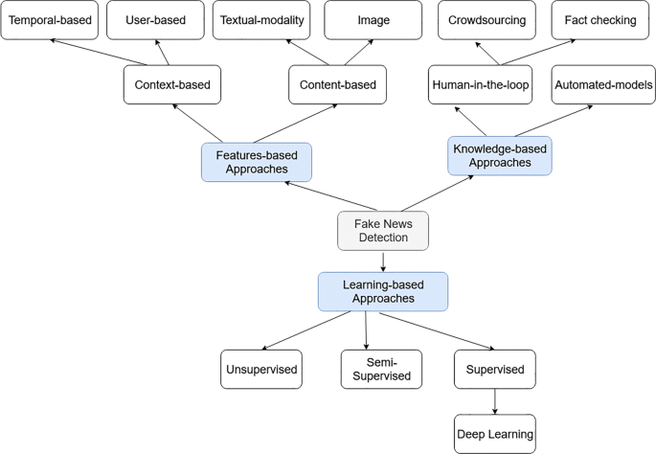
Concept Tree

Slide 4
Literature
Author(s) | Strategies | Advantages | Disadvantages
Xavier Jose, SD Madhu Kumar and Priya Chandran | Characterization Classification and Detection of Fake News in Online Social Media Networks | The stance detection model and the fabricated content classifier are the main two components of the solution | Accuracy of the model is 80 percent
Oluwaseun Ajao, Ashish Garg and Márjory Da Costa-Abreu | Exploring Content-Based and Meta-Data Analysis for Detecting Fake News Infodemic | A content-based approach combined with metadata as well as an initial feature analysis is used predicting misleading posts. | NLP methods are used to check similarity of news by comparing fake and posted news
S. Han, S. Zhao, Q. Li, C. H. Ju | Huntpedia: Your Threat Hunting Knowledge Compendium | hunters are the network security equivalent of beat cops; they search for anomalies by patrolling through data | Hunting requires the input of a human analyst and is about proactive, hypothesis-based investigations
Parita Jain, Swati Sharma, Puneet Kumar | Classifying Fake News Detection Using SVM Naive Bayes | we propose various techniques to verify that the collected news is fake or not. | Natural Language Processing (NLP) is used. Various other methodologies like text classification methods accuracy is less
Ana LC Bazzan and Marcelo De Souza | Liar liar pants on fire; or how to use subjective logic and argumentation to evaluate information from untrustworthy source | Data-Oriented Belief Revision Operator, that uses a trust model, subjective logic, and a preference-based argumentation framework to evaluate novel information and change the agent’s belief set accordingly. | some form of trust-based non-prioritized belief change operator is necessary

Slide 5
Literature(cont..) selected strategy:
Author(s) | Method | Advantages | Disadvantages
Xavier Jose, SD Madhu Kumar and Priya Chandran | fabricated content classifier | Predicts fake news or genuine news | Accuracy of the model is below 85 percent
Oluwaseun Ajao, Ashish Garg and Márjory Da Costa-Abreu | Cosine similarity and NLP techniques are used | A content-based approach combined with metadata as well as an initial feature analysis is used predicting misleading posts. | NLP methods are used to check similarity of news by comparing fake and posted news
S. Han, S. Zhao, Q. Li, C. H. Ju | SIEMs, purpose-built hunting platforms like Sqrrl, open source software | hunters are the network security equivalent of beat cops; they search for anomalies by patrolling through data | Hunting requires the input of a human analyst and is about proactive, hypothesis-based investigations
Parita Jain, Swati Sharma, Puneet Kumar | SVM Navie bayes | we propose various techniques to verify that the collected news is fake or not. | Accuracy of the model is less below 80 percent
Ana LC Bazzan and Marcelo De Souza | ODD protocol was designed to standardize the method for describing Agent-Based Models | Data-Oriented Belief Revision Operator, that uses a trust model, subjective logic, and a preference-based argumentation framework to evaluate novel information and change the agent’s belief set accordingly. | some form of trust-based non-prioritized belief change operator is necessary

Slide 6
Problem Statement
Classification of any fake message item /post / blog into fake or real one has generated great interest from researchers around the globe.
Several research studies have been carried out to find effect of falsified and fabricated news on masses and reactions of people upon coming through such news items.
Falsified message or fabricated post message is any textual or non-textual content that is fake and is generated so the readers will start believing in something which is not true

Slide 7
Problem Illustration
Existing methos are developed on Natural language process and Few machine learning techniques which has less accuracy and prediction of fake new is not up to mark. A effective algorithm is needed to predict fake messges
data | Algorithms | Accuracy
Fake message dataset | Cosine similarity | 80
Fake message dataset | SVM | 86
Fake message dataset | Navie bayes | 82

Slide 8
Proposed Method
In this project, we propose to study the fake message detection problem in online social networks. Based on various types of heterogeneous information sources, including both textual contents/profile/descriptions and the authorship and article subject relationships among them, we aim at identifying fake news by training from collected dataset using passive aggressive classifier. We formulate the fake news detection problem as a credibility inference problem, where the real ones will have a higher credibility while unauthentic ones will have a lower one instead. .
We improve accuracy above 90 percent and predict fake messages with more accuracy.

Slide 9
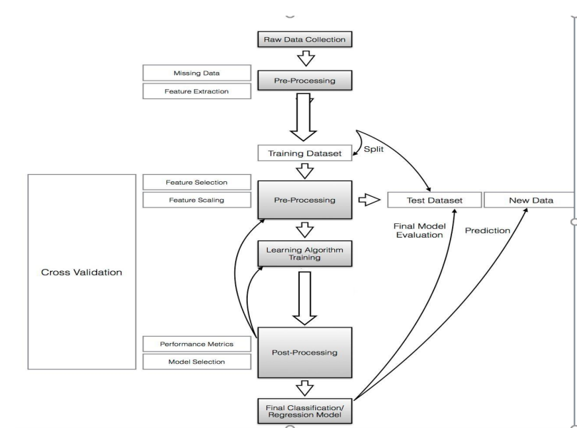
Proposed Method Illustration

Slide 10
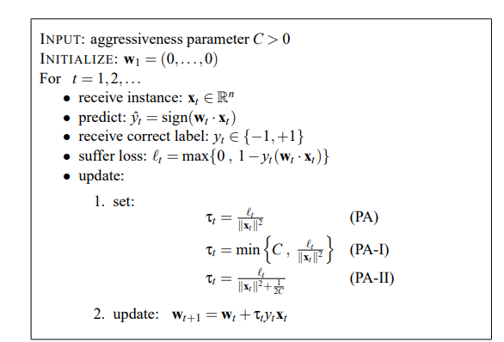
Parameter
Dataset:
Fake message data set has these three features title text label dataset has 8000 fake messages and real messages data with label as fake and real. This dataset is used to tarin model and predict result.
Machine Learning Passive Aggressive Model:

Slide 11
Experiment Environment
Software Requirements:
Operating System - Windows XP
Coding Language - python
Front End - Html,css
IDE - Anaconda
Back End - MySQL

Slide 12
Project status
S.No | Functionality | Status (Completed /in-progress/Not started)
1 | Data collection | Completed
2 | Data split and train model | Completed
3 | Accuracy of model is calculated | Started
4 | Web application html pages using flask | pending

Slide 13
References
Niall J Conroy, Victoria L Rubin and Yimin Chen, "Automatic deception detection: Methods for finding fake news", Proceedings of the Association for Information Science and Technology, vol. 52, no. 1, pp. 1-4, 2015.
Mykhailo Granik and Volodymyr Mesyura, "Fake news detection using naive bayes classifier", 2017 IEEE First Ukraine Conference on Electrical and Computer Engineering (UKRCON), pp. 900-903, 2017.
Junaed Younus Khan, Md Khondaker, Tawkat Islam, Anindya Iqbal and Sadia Afroz, A benchmark study on machine learning methods for fake news detection, 2019, [online] Available: .
Cédric Maigrot, Ewa Kijak and Vincent Claveau, "Fusion par apprentissage pour la détection de fausses informations dans les réseaux sociaux", Document numerique, vol. 21, no. 3, pp. 55-80, 2018.
D S K R Vivek Singh and Rupanjal Dasgupta, Automated fake news detection using linguistic analysis and machine learning.

Slide 14
Thank you

Slide 15
Project seminar–I Evaluation
S.No | Rubrics | Marks
1 | Concept Introduction | 4
2 | Literature and Parameter | 5
3 | Problem and Problem Illustration | 8
4 | Proposed Method and Illustration | 8
Total |  | 25

